Slide 1
IEEE Central Texas Section
2019 Fall Leadership Planning Meeting
August 24, 2018
San Marcos, TX
Section Committee/Officer Name: Jim Brakefield, Chair
Chapter/Affinity Name: San Antonio Life Member group
Prepared by: Jim Brakefield

Slide 2
Vision, Leadership Team
OU Name: San Antonio Life Members affiliate group
Vision/Objectives/2019 Focused Initiatives
Monthly lunch-time meetings with speaker
Grant to build displays for SAMSAT museum
Texas Tour in October
Leadership Team
Position Name Email
Chair Jim Brakefield jim.brakefield@ieee.org
Vice Chair Garrett Polhamus polhamus@ieee.org
Treasurer Scott Atkinson s.atkinson@ieee.org
Secretary John Lyons jlyons@ieee.org

Slide 3
2019 Key Accomplishments
Meetings (month, topic, L31): IEEE Total
Jan 17 The USAF Airborne Laser Program 16 21
Feb 21 Research for Nuclear Powered RamJet Missile 15 27
Mar 21 Multi-Factor Authentication at USAA 16 19
April 18 Tour of Scobee Planetarium 16 22
May 16 Texas Volkswagen Environmental Mitigation Program 19 21
June 20 The Yagi antenna - how it works, and some history 20 23
July 19 NewTek IP Workflow & Scaleable Video Performance 13 16
Aug 15 Cybersecurity Exhibit at SAMSAT 13 14
(3+) SAMSAT Mtgs 5 13-18
(1) Planning Mtgs 5
Other Activities/Events:
Grant to build several exhibits for San Antonio Museum of Science & Technology (SAMSAT.org)
Texas Technical Tour
Support for San Antonio BEST

Slide 4
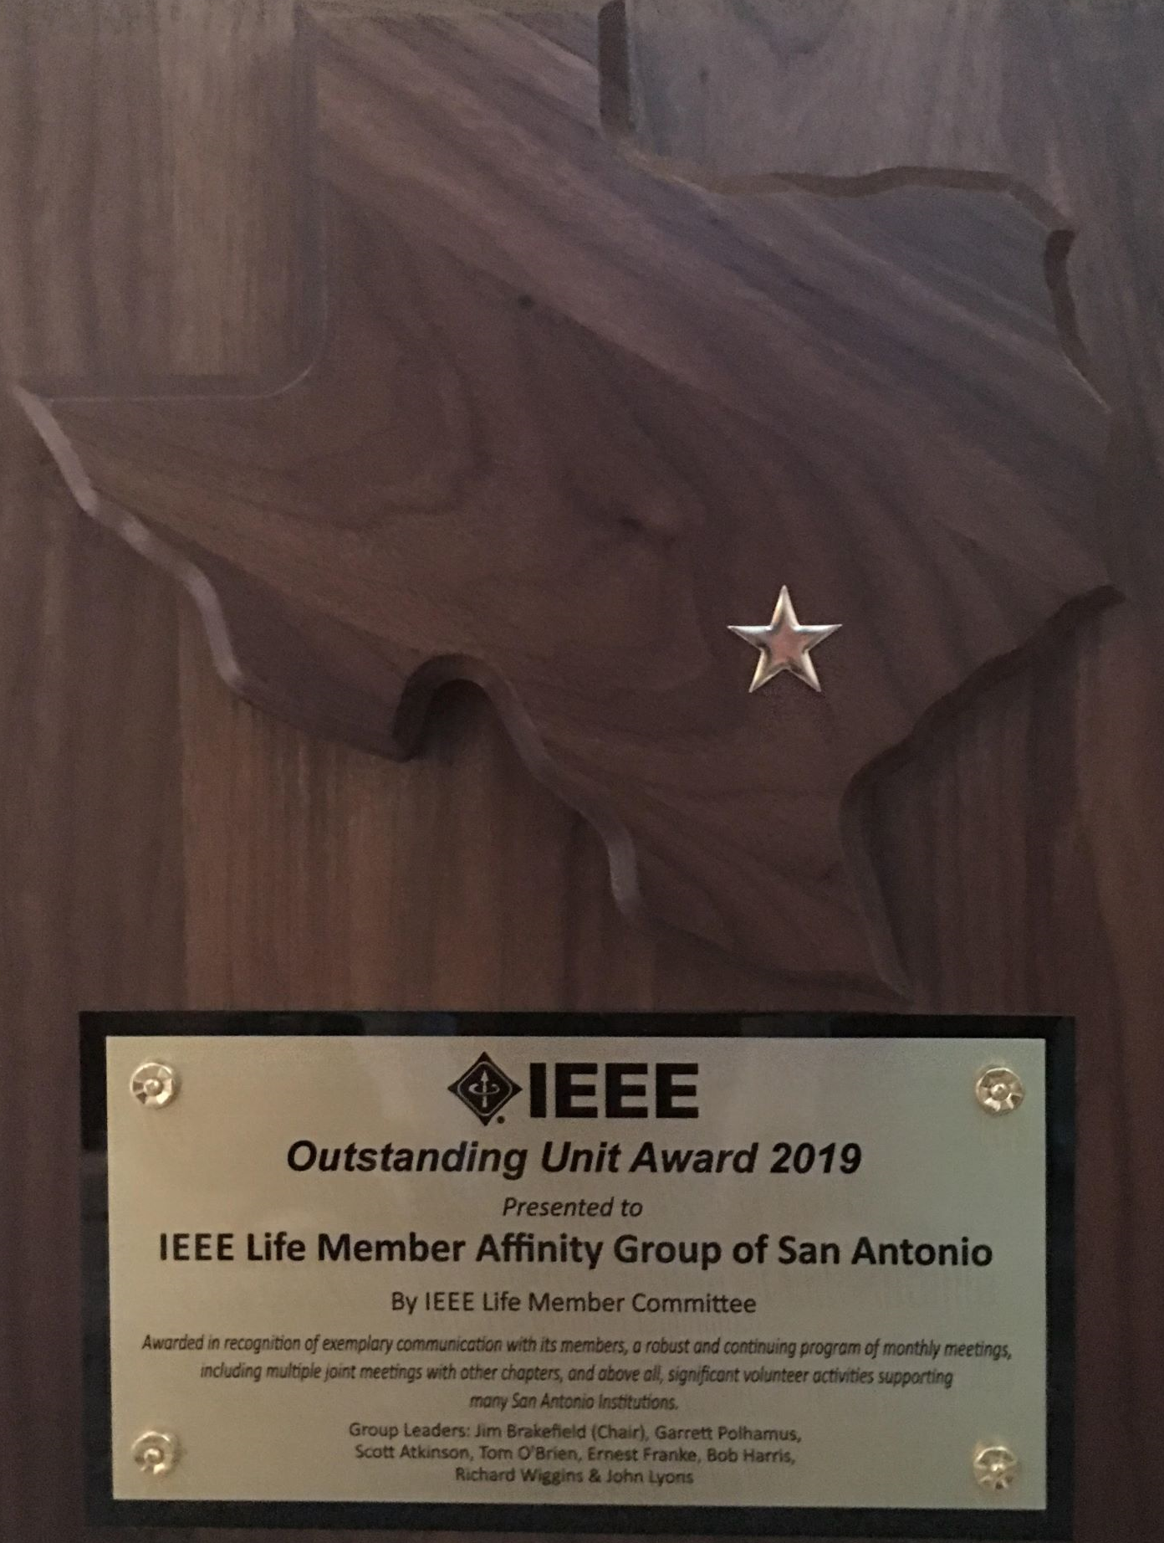
2019 Chapter Vitality & Help Needed
Chapter Vitality Assessment: Strong
2019 has been a very good year:
Best LM chapter in the world!
Texas Technical Tour fully subscribed
50% complete on SAMSAT exhibits
Top Help Needed/Issues
Need candidate for 2020 Vice Chair

Slide 5
LM and SAMSAT financials (as of Aug 7)
LMAG Actuals (Managed by Jim Brakefield)
Revenues $2,996.00
Expenses $708.69
Net $2,287.31
Plus Interest $314.32
Plus LMC Balance Of the $2,000 = $1,673.24
Total Available funds for LMAG $4,274.87
SAMSAT Grant (Managed by Ernest Franke)
Revenues $31,440.00
Expenses $4,450.32
Net of recived funds $26,989.68
Balance of Grant funds not yet received = $7,560

Slide 6
Texas Tour financials (as of Aug 7)
Texas Tour (Managed by Scott Atkinson)
Income - $157,188.97 (incl $5,000 loan)
Expenses @10,601.74
Net $146,587.23
Less $5,000.00 to CTS
Balance $141,587.97
All hotel bills & the Tour Bus Contracts are paid by IEEE Master Account
All other expenses to be paid by check or VISA Bank Card.
Our budget currently is projected to yield a 10% surplus

Slide 7
CTS Leadership
CTS Officers
Chapters/Affinity
Standing Committees/Coordinators
Chair
Fawzi Behmann
Vice Chair – A
Heena Rathore
Vice Chair – SA
Nils Smith
Secretary
Treasurer
Bill Martino
Past Chair
Leslie Martinich
Student Branch
Student Branch Chapters
Strategic Plan
Policies and Procedures PARP
Awards and Recognition
Nomination Committee
Election Committee
FIN/Audit Committee
Membership Development
Electronics Communications
Website
Communications Portal
Conferences/Events
Section-Chapter Vitality Chair
K-12/STEM Educational Activities
Students Activities
Professional Activities – PACE
Outreach Program
Conferences/Events

